Slide 1

FLEET PROGRAM CHANGES

Slide 2


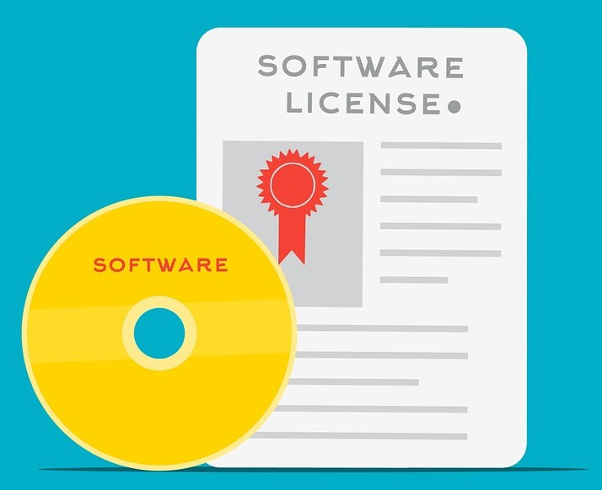


Fleet Program
Completed Tasks
Fleet Policy Update
Vehicle Reconciliation
Implemented
Software
Pool Vehicle Program
Maintenance Plan

Slide 3


Fleet Program
Upcoming Tasks
Training
Rollout

Slide 4




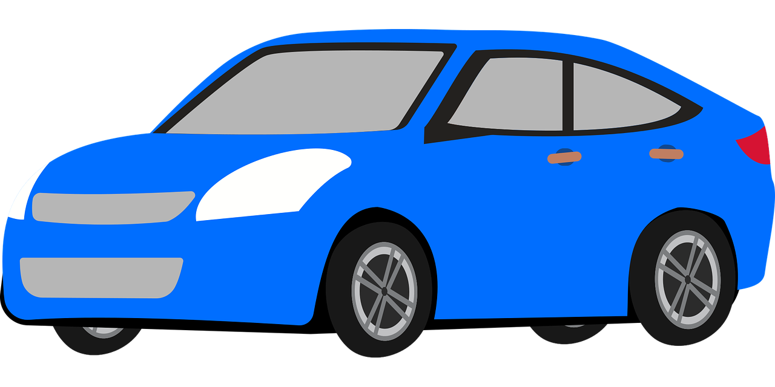
What do we need from you?
In-House Maintenance Scheduling
Outside Repair Services
Inspection Scheduling

Slide 5
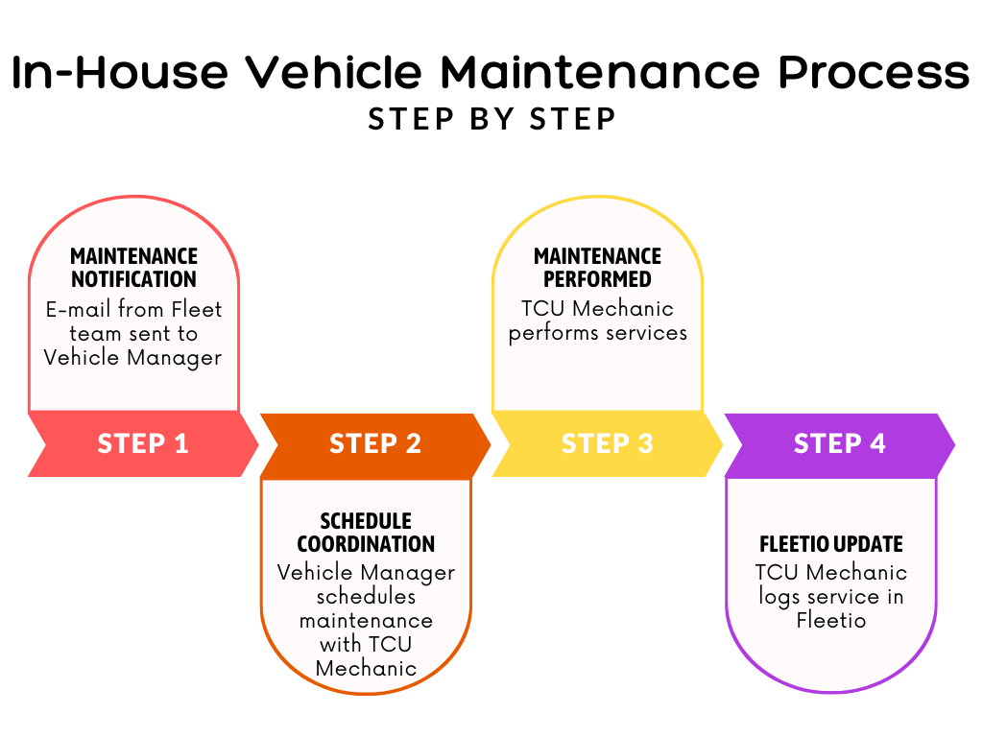

Slide 6
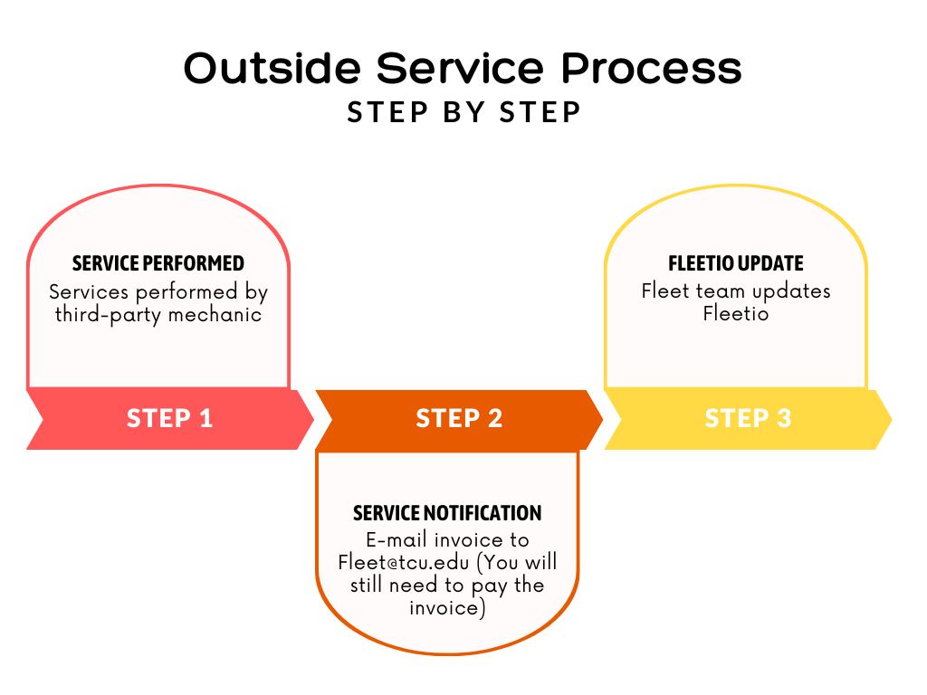

Slide 7
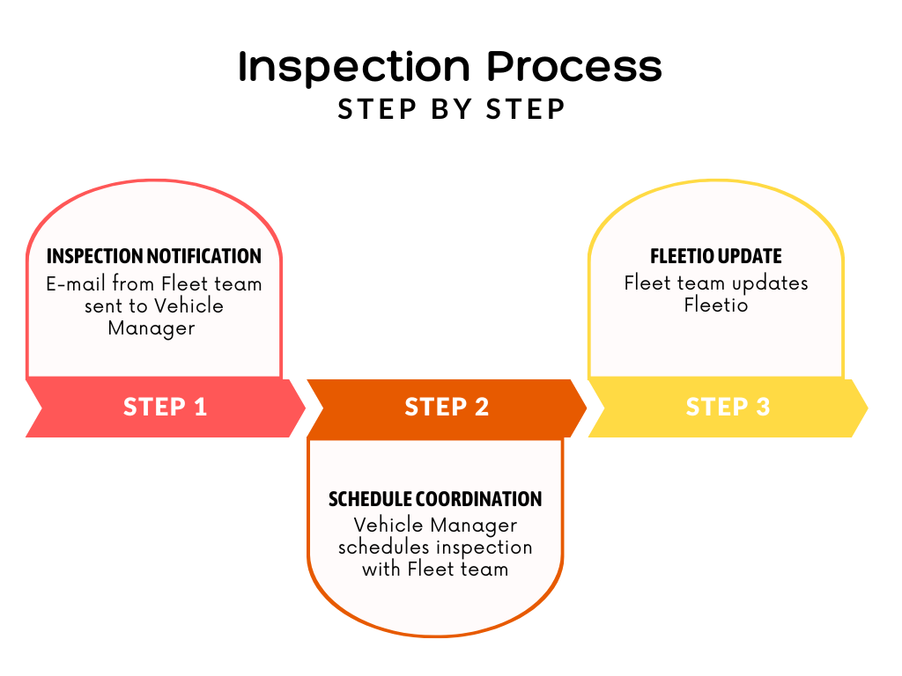

Slide 8

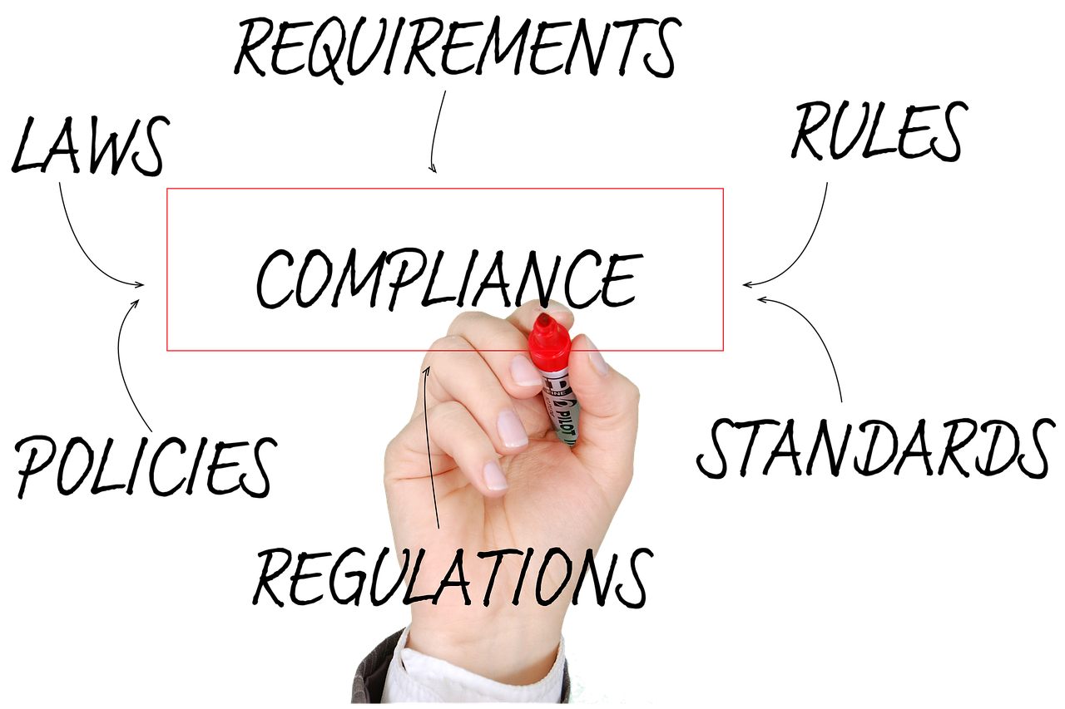
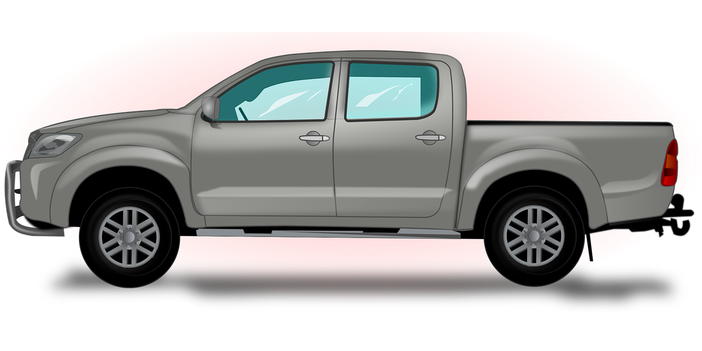
What’s in it for me?
Policy Compliance
Safety
Vehicle Replacement

Slide 9
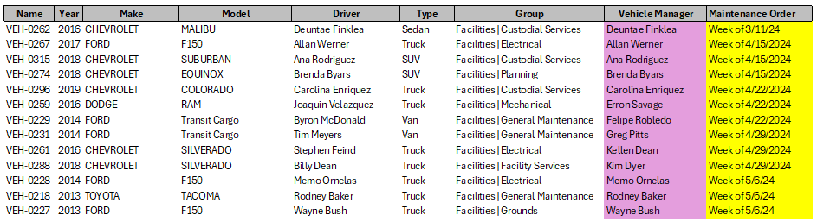
Next steps
Maintenance Go-Live: 4/15/24
Inspection Go-Live: 4/08/24
Vehicles Deactivated in AiM: 4/30/24

Slide 10

I Have Questions!!
E-mail us at:
Fleet@tcu.edu

Slide 11
Resources
TCU Fleet Policy: http://tcusafety.tcu.edu/wp-content/uploads/2024/04/TCU-Fleet-Management-Guide-March-2024.pdf
Pool Vehicle Program: https://tcu.box.com/s/bz5rb3mzumfzwld4na1zk9g5jovvnz65
Fleetio Training Materials: https://tcu.box.com/s/ou9bvjsbjhkigfp54wfw279auhequurm

Slide 12
THANK YOU

